Slide 1
Fetching data from server
by Taras Nahornyi

Slide 2

XMLHttpRequest
An API in the form of an object whose methods transfer data between a web browser and a web server.
Internet Explorer 5.0, 1999

Slide 3

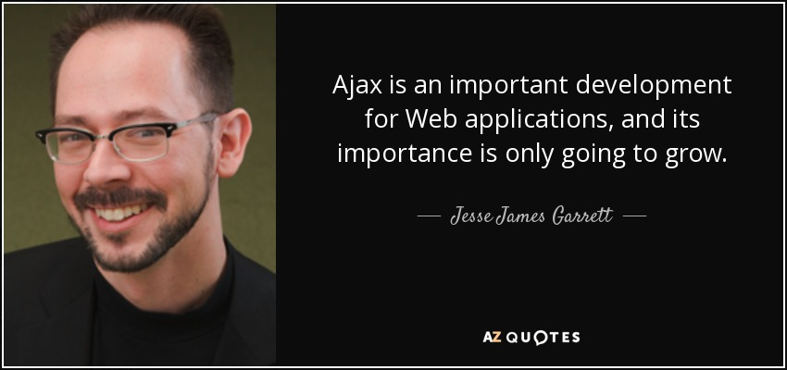
(Asynchronous JavaScript And XML)
February, 2005

Slide 4
AJAX
HTML (or XHTML) and CSS for presentation
The Document Object Model (DOM) for dynamic display of and interaction with data
JSON or XML for the interchange of data, and XSLT for XML manipulation
The XMLHttpRequest object for asynchronous communication
JavaScript to bring these technologies together

Slide 5
Alternatives to pure AJAX
Axios – http library
Fetch API – built-into a browser
Superagent
Ky
Prototype
Node HTTP
jQuery

Slide 6
Fetch API
Simple, easy-to-use version of XMLHttpRequest to consume resources asynchronously.
came few years ago
built into modern browsers (older need polyfill)
has short notation
capable of reproducing the key features of AJAX

Slide 7
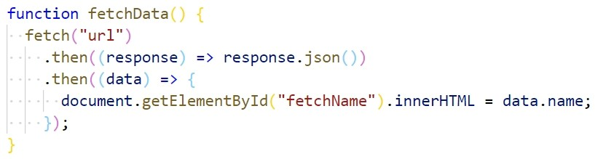
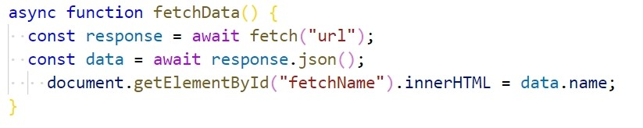
Fetch API
Promise syntax
Async/await syntax

Slide 8
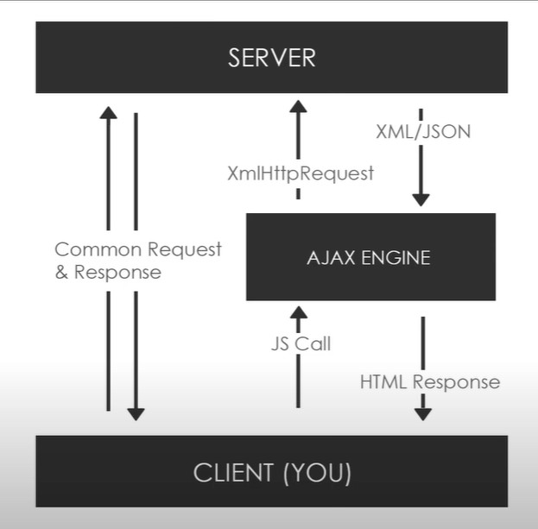
AJAX

Slide 9
AJAX
Create an XMLHttpRequest object :
const xhrobj = new XMLHttpRequest();
xhrobj.open(' POST ', 'example.com/post', true);
Send the request :
xhrobj.setRequestHeader("Content-type", "application/x-www-form-urlencoded");
xhrobj.send("username=john");
Receiving and rendering the response :
xhrobj.onreadystatechange = function () {
if (this.readyState == 4 && this.status == 200) {
document.getElementById("response").innerHTML = xhrobj.responseText;
}
}

Slide 10
AJAX
readyState Values:
0: request not initialized
1: server connection established
2: request received
3: processing request
4: request finished and response is ready

Slide 11
AXIOS
Popular JavaScript library you can use to perform HTTP requests, that works in both Browser and Node.js platforms
supports older browsers (Fetch needs a polyfill)
has a way to abort a request
has a way to set a response timeout
has built-in CSRF protection
supports upload progress
performs automatic JSON data transformation
works in Node.js

Slide 12
AXIOS installation
Using jsDelivr CDN:
<script src="https://cdn.jsdelivr.net/npm/axios/dist/axios.min.js"></script>
Using unpkg CDN:
<script src="https://unpkg.com/axios/dist/axios.min.js"></script>
/ npm install axios .
or

Slide 13
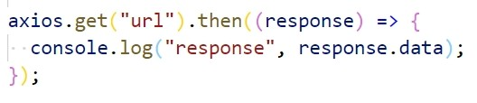
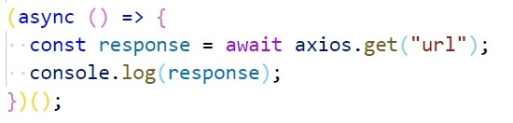
AXIOS
Promise syntax
Async/await syntax
axios.get()
axios.post()
axios.delete()
axios.put()
axios.patch()
axios.options()

Slide 14
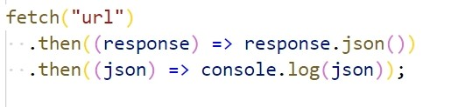
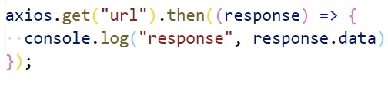
Amount of code
Fetch
Axios
Have to deal with two promises
Have an access to json-object in a data property of response

Slide 15
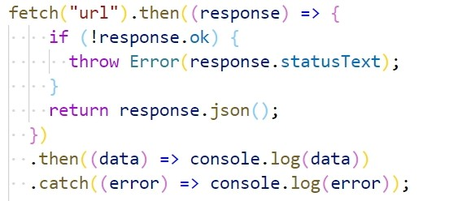
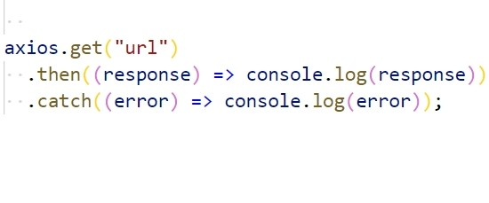
Error handling
Fetch
Axios
Need to check if status is a success.
Axios checks if there’s a network error

Slide 16
Data uploading progress
Fetch
Axios
Has no opportunity to monitor
Important for sites where users need to control the process of uploading and downloading big amount of data
Can monitor the data uploading

Slide 17
Is AXIOS alive?
2019
Contributions have been scarce
Issues are not addressed
PRs are ignored
Little communication
2020

Slide 18
Sources:
https://jsonplaceholder.typicode.com/
https://developer.mozilla.org/en-US/docs/Web/API/Fetch_API
https://www.quora.com/What-was-used-before-AJAX-came-out-to-interact-with-the-server-side
https://www.youtube.com/watch?v=82hnvUYY6QA&t=1732s
https://www.npmjs.com/package/ajax
https://github.com/axios/axios/issues/1965
etc…

Slide 19


